Slide 1
Coding the Light Fantastic: The Digital Translations of Yesterday
Jesse Gray
Fowzia Sharmeen
CSU Northridge

Slide 2
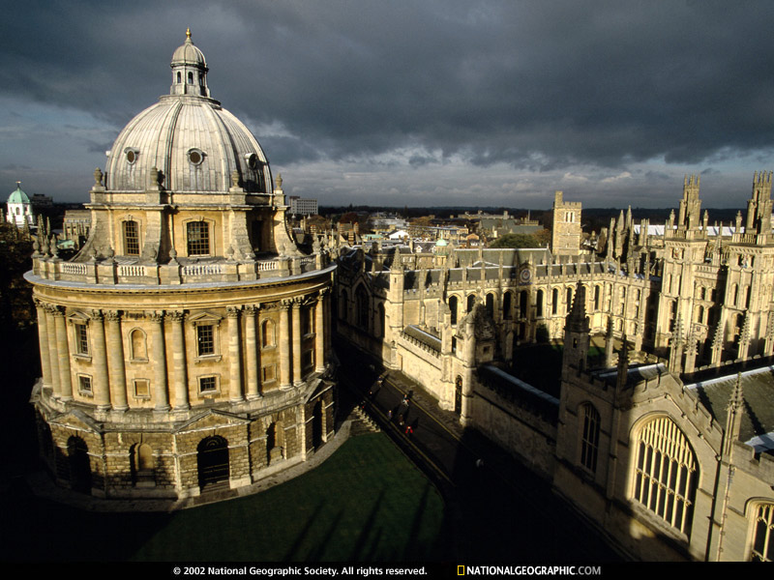
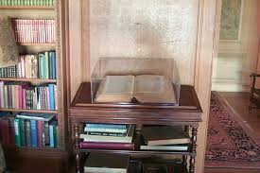
Bodleian Laud misc 108

Slide 3
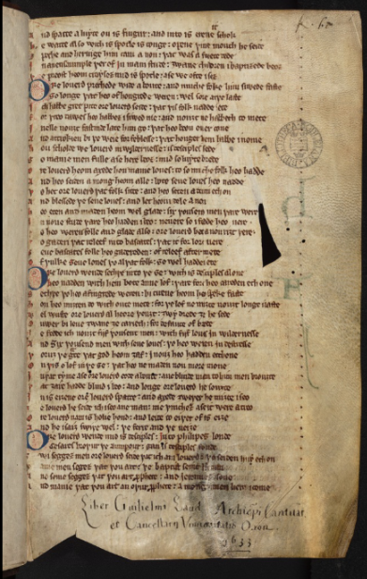
13th-15th century
vernacular texts
South English Legendry
Matter of England romances
Various religious poems

Slide 4
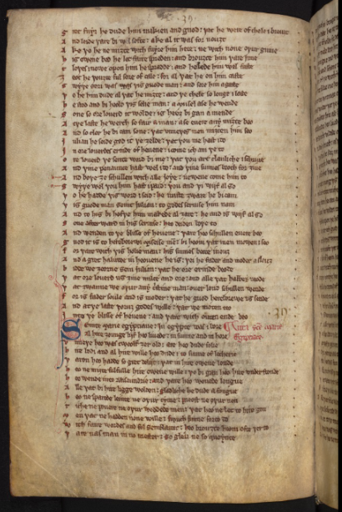


Objective
To transcribe a portion of the SEL:
Mary of Egypt
117verso to 121 verso
Describes her life, death, and sainthood

Slide 5
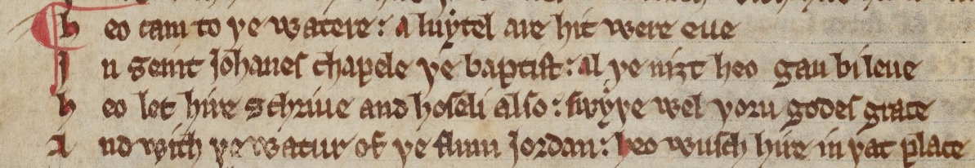
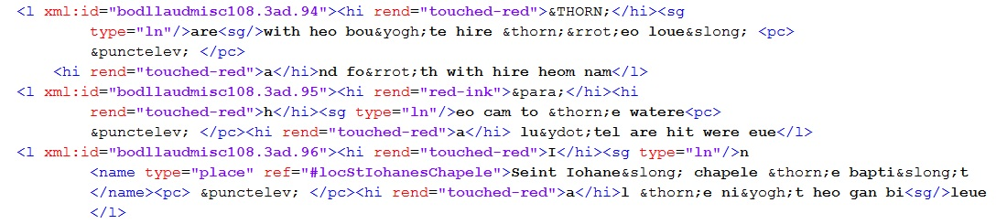
From Middle English to XML

Slide 6
Two Primary Questions
What do you code?
How do you code it?

Slide 7


Easier things to code:
Special letters Flourishes Latin

Slide 8

More challenging attributes:
Mistakes and errors
Hard to describe errors
Carets
Carets

Slide 9
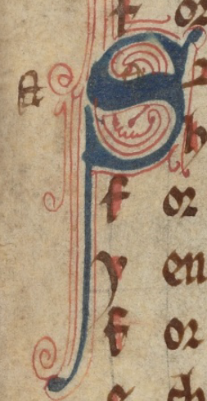
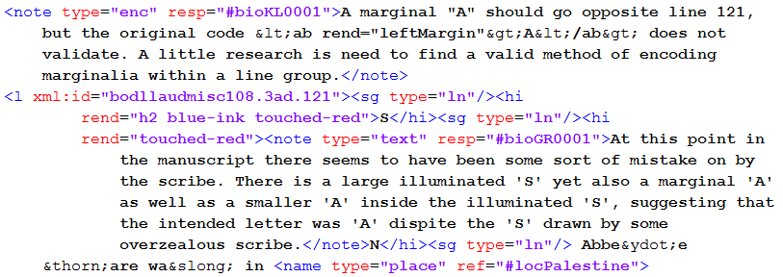
Extremely hard to describe errors
Corrections by overwriting and noting on the margins

Slide 10
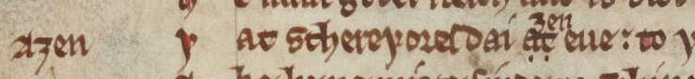
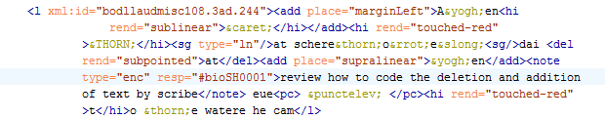
Marginalia, Splotches, & Overwrites:

Slide 11
Editions
Diplomatic edition: attempts to represent original document
Critical edition: makes some fairly interpretive editorial decisions
-recovering damaged texts --- using another copy (not 100%)
- embedding meanings
- tracking data

Slide 12
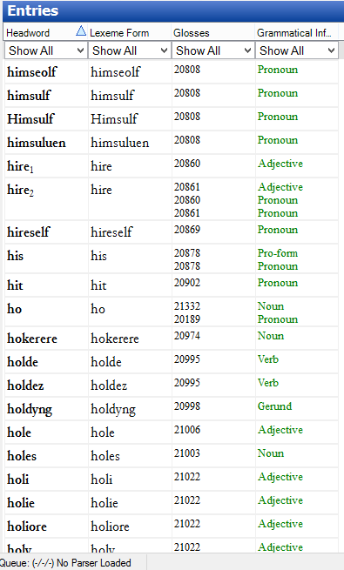
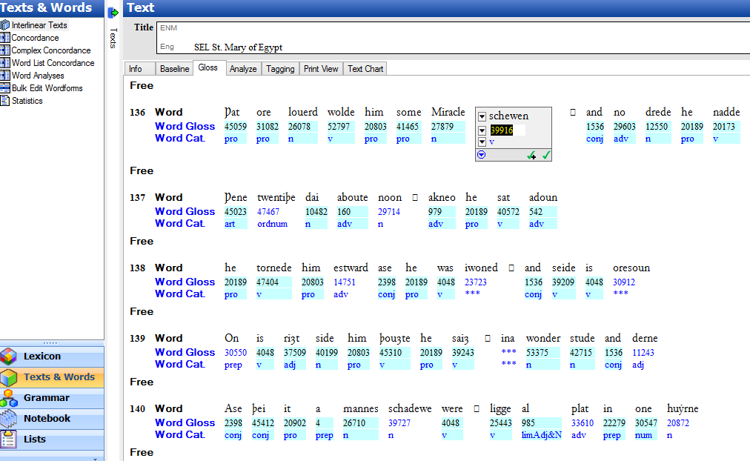
Embedding information
Glossary

Slide 13
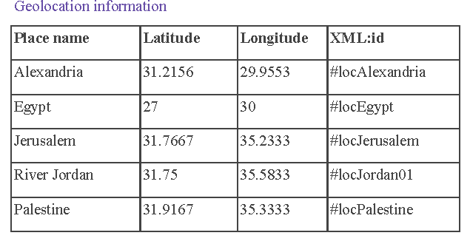
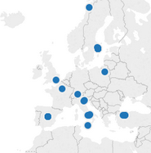
Visualize Text Data
Geo Tagging
Use this information to…
…map it, similar to this.

Slide 14
Multiple Skillsets & Resources
Skillsets
Resources
Paleography
XML: Text Encoding Initiative (TEI)
Using various softwares:
  Oxygen
  SIL Fieldworks Explorer
  Etc.
Searching/using databases
Archive
Geotagging
Google Drive (Archival purposes)
Various other sharing resources:
  Github
  Box
SIL Fieldworks Explorer
Middle English Dictionary (MED)
Geotagging software
Coding software

Slide 15
Project Model: Instruction
Scholar/Professor
Student
Student
Student
Student
Student
Student

Slide 16
Project Model: Collaboration
Scholar/Professor
Student
Student
Student
Student
Student
Student

Slide 17
Implications for the Future…
Continuous Remediation
Greater Accessibility
Collaboration

